Slide 1
Spotify Analysis
File created on: 8/2/2023 2:14:05 PM

Slide 2
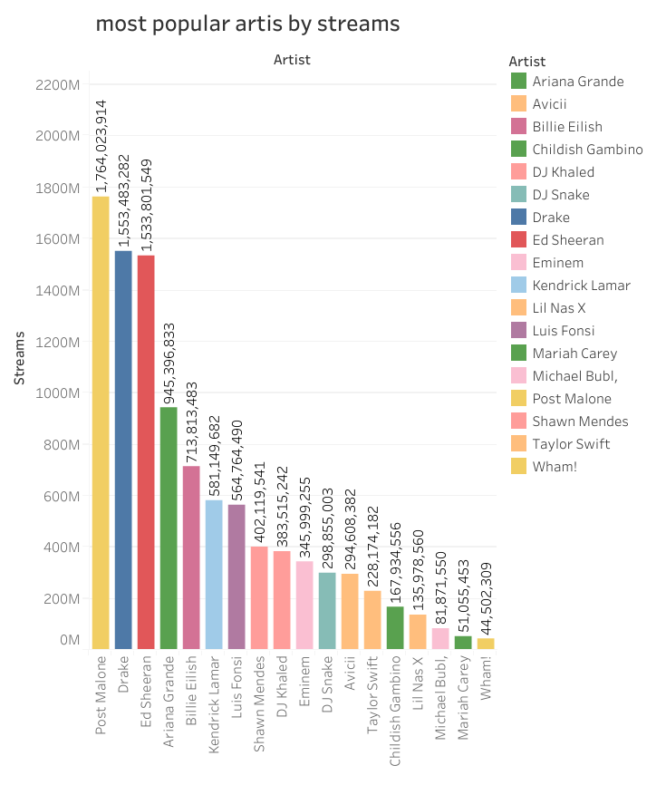

Slide 3
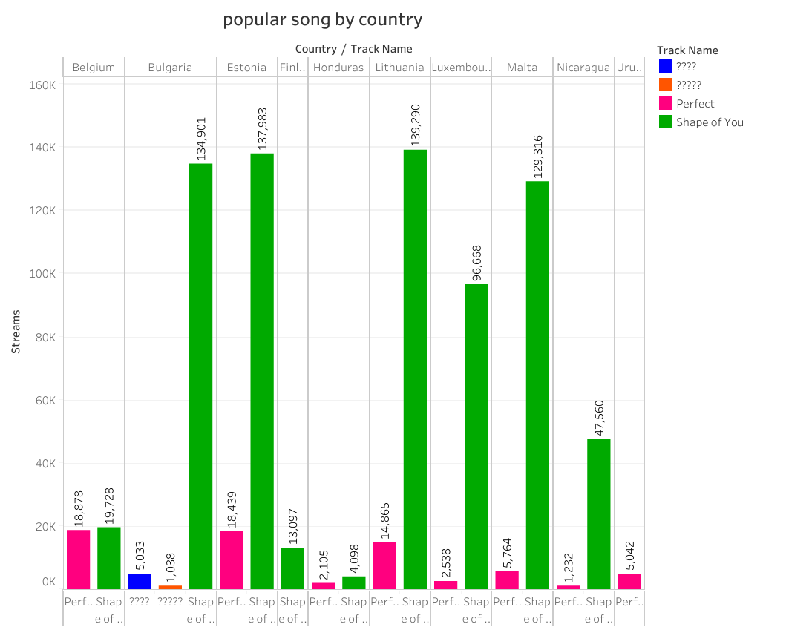

Slide 4
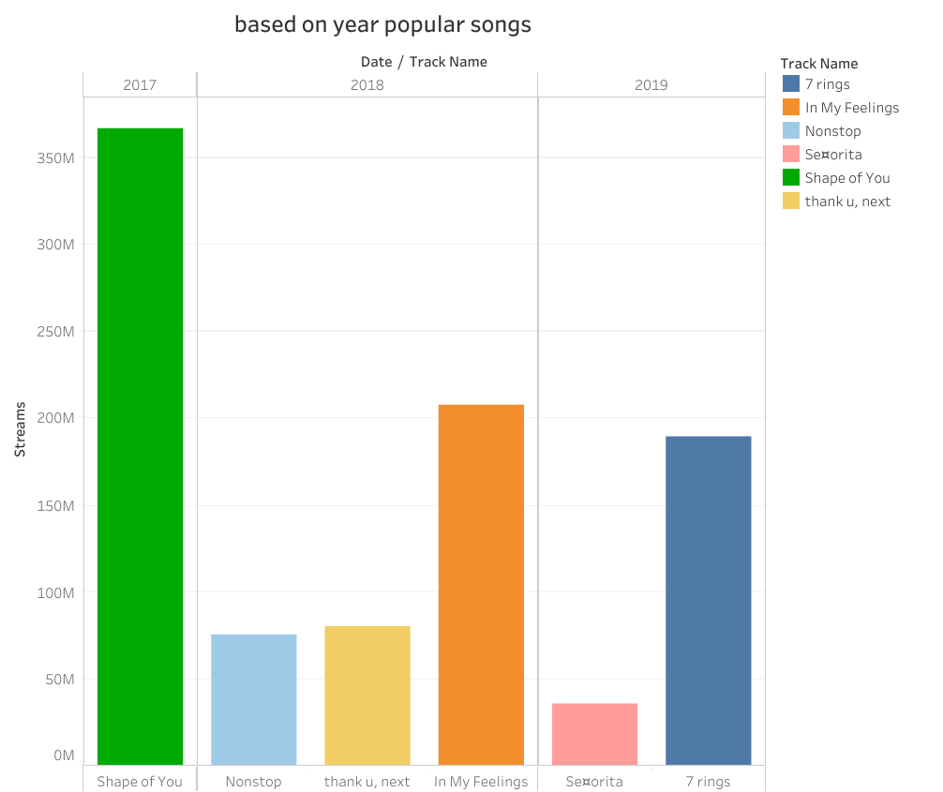

Slide 5
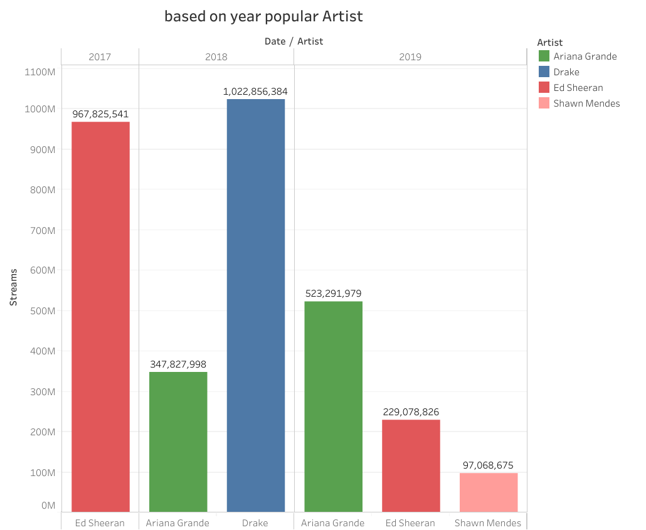

Slide 6
